Slide 1
Agent Management
H2 2020

Slide 2

Context
There is no single place to find information about agents.
The management of our agent network is being done across multiple spreadsheets.
Information, activities and communications are held across multiple tools and teams.
The current tooling landscape is overly complex - making it more costly to maintain, difficult to scale outside Nairobi, and impossible to sell as a SaaS solution.
Agent product offering is believed to be too complex for agents.
Reconciliation of agent payments is done manually.

Slide 3
Who we spoke to?
Names are different across systems
Everyone comes to me because there is no unified view of agent
My spreadsheet is ‘the source of truth’ [All]
Team | Individual | Status
Agent Sales | Cynthia | Done
NOC | Sharon | Done
Deployment | Peter | Done
Finance | Humphrey | Done
Legal | Ashaba | Done
Fuels | Michael | Done
Marketing Ops | Naushad | Done
Stoves | Hezbon | Done
To do this, x sends me an email
The is no visibility on the health of an agent e.g. performance, sales, opening hours
Nowhere to track costs and spend
We can’t track communications, activities and disputes across agents
Can’t do tasks myself - a lack of access, training and automation

Slide 4
Approach and Roadmap
How do we solve this

Slide 5
Agenda for 10th September
The roadmap as it currently stands
What’s next after UVA?
UVA: Targeting week 40 for our first release; what’s in it and how should we plan to do business adoption activities?

Slide 6
Agent Roadmap H2 2020
Key
Not Scoped
Scope well understood
Release
Main objectives of Unified View of Agent Project
Custom fields
> Ease of access to agent related data
> Stop the reliance of spreadsheets to capture agent related data
> Reduce Odoo license cost
Search Agents on KOKO Admin
Decommissioning
Tags
Agent page on KOKO Admin
Agent payments processing
Entity Status transitioning
Agent product offering changes
Architectural changes
Agent & Shop creation
Agent task managemnt
Data Migration
Improved KP Deployment
Aug
Sept
Oct
Nov
Dec
Jan 2021(TBD)

Slide 7
What next?
In the next two weeks we need to have a clear view of what we want to take up next:
Process / Functionality | Scope | Recommendation
Onboarding / Deployment | Needs review | Accurate entity / shop state is reliant on this being on system
Offboarding / Decommissioning | Needs review | Accurate entity / shop state is reliant on this being on system
Tags | Scoped | This can add value for all very quickly; can also be used as a proxy for states e.g. do not fill / has an issue
Agent Task Management | Some dependent on other projects but high value items could be taken forwards e.g. knowing a shop visit has taken place | Defer unless we think it would improve agent experience? Because until onboarding / offboarding is there the Agent Network team won’t be fully using UVA?
Start with decommissioning
or
tags and high value agent management

Slide 8
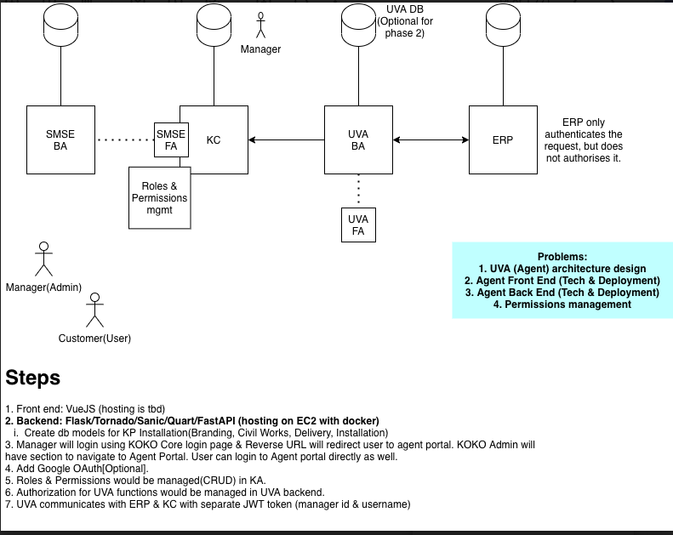
Architectural Changes

Slide 9
Unified View of Agent
Scoped and in delivery
Summary
We need to ensure that everyone involved in the agent value chain has a single source of truth for data to drive better service delivery to our agents.
Included
In Scope
Unified view of the agent on KOKO Admin for all of the operational and support teams to access agent info.
Central place to onboard and offboard agents in KOKO Admin.
Incorporate critical information from spreadsheets into KOKO Admin / Odoo to drive the single source of truth.
Define the different states an agent, shop or KOKOPoint can be at in the life cycle.
Risks / Considerations
We need to ensure that critical information comes out of the spreadsheets that are being used and stop the need to create new spreadsheets.
EXCO
Matt/Ari
Size
Large
Stakeholders
Deployment, Legal, fuel logistics, distribution, network operations, customer care, agent sales
Current Phase
Delivery

Slide 10
Agent task management
Is this next after UVA? Is this the right key processes / gaps to be addressed?
Summary
The goal here is to get first hand and instant feedback from field teams(fuel delivery, cooker distribution, NOC maintenance, calibration team). This leads to decisions being based on real time information to save effort and time taken to visit shops that are otherwise closed or inaccessible.
Included
In Scope
Capture failed visits by operational teams to the agent location i.e fuel delivery, cooker distribution, KP maintenance, calibration
Escalate frequent failed visits to the agent sales team to engage the agent for next steps
Provide an option for agent sales to suspend/unsuspend shop visits by field teams
Risks / Considerations
New feature to be added on the Tanker Operator app and KOKO Mile app will be required
Integration with Tookan will be required
EXCO
Ari
Size
Medium
Stakeholders
Fuel logistics, cooker distribution, network operations, agent sales
Current Phase
Scoping

Slide 11
Agent task management - ARZ slide
There are currently 7 teams that regularly interact with Agents. Information is shared via Google Sheets, Freshservice, Zendesk, WhatsApp and email.
We want to log all Action interactions in 1 place
We want to drive business actions based on outcomes of Agent interactions
Use system logic / business rules to automate actions / tasks based on summary of Agent interactions
Agent Network
Customer Sales
Customer Care
NOC
Fuel Logistics
Cooker Distribution
Deployment
Shop closed
Stock requests
Fuel
Cookers
KP issues
Commission issues
Other
Shop closed
Stock requests
Fuel
Cookers
KP issues
Other
Stock requests
Fuel
Cookers
KP issues
Commission issues
Other
Shop closed
Road inaccessible
Power issues
Emergency switch
Other
Fuel planning
Shop closed
Road inaccessible
Other
Cooker planning
Shop closed
Road inaccessible
Limited space
Missing cookers
Other
Agent refuses decommissioning
Spreadsheets where this information is captured (not exhaustive)
L3 Agent Prioritization
Cooker Stock Daily Tracker
Problem Agent Tracker
AN Problem Tracker
Agent Feedback Form
KP Decommissioning Requests

Slide 12
Improved KP deployment
Summary
We should have a mobile app to manage the repeated processes around KOKO Point deployment (inspection, civil works, deployment, etc.). Right now, everything is done on Google Forms / Sheets, which is unwieldy and off system.
Included
In Scope
Mobile app for capturing field activities during deployment process i.e inspection, civil works, delivery, installation, fueling, calibration
Scheduling activities from KOKO Admin agent page for each of these activities
Risks / Considerations
Needed to support Q3 plan growth of 75 new agents
Consider the 3rd party contractors(Lynk, SG, Weights & measures) who might need access to an app or our system
EXCO
Ari
Size
Large
Stakeholders
Deployment, fuel logistics, network operations, agent sales
Current Phase
Scoping

Slide 13
Agent payments processing
Summary
Currently, there is no process available to reconcile the vendor bills with the draft payments created through schedulers. This process is done manually and takes days of effort with little value addition in this approach.
Included
In Scope
Find a way to capture the actual agent payable amount in Odoo
Update when agents have been paid
Better invoicing structures that make sense for our business
Risks / Considerations
What is there today is overly complex, not fit for purpose and needs overhauling as has become a concern for auditors
EXCO
Ari
Size
Medium / Large
Stakeholders
Finance, agent sales
Current Phase
Scoping

Slide 14
Agent product offering changes
Summary
The agent product is believed to be too complex for agents and needs to be redesigned to improve profitability for agents and KOKO.
Included
In Scope
Remove advertising fees
Provide meaningful monthly statements and payouts
Add sales incentives
Risks / Considerations
More discovery required but some ideas that have been discussed:
EXCO
Ari
Size
TBD
Stakeholders
Finance, agent sales
Current Phase
TBD

Slide 15
Agent Architecture
Data Questions

Slide 16
Agent Entity Relationship Diagram
Odoo
An agent is the individual with who KOKO enters an agreement to provide KOKOpoints.
The shop is the location the agent provides for KOKOpoints. An agent can own many shops.
Customers visit shops to buy fuel from KOKOpoints. We are trialling multiple KPs in shops.
The problem involves linking information between these two systems and then linking this to information about KPs and shops which is largely held on spreadsheets.
Agent
0..1
owns
1..n
Shop
1..n
houses
KOKO Core
0..n
KOKOpoints

Slide 17

UVA - Initial approach (i.e. Aug - Sep)
UVA was intended as a front end view which displayed combined data from a number of sources and allowed users to edit those fields.
In order to get off the spreadsheets fields were created in Odoo and the data would be migrated from sheets to those fields.
Once core data was migrated the sheets could be retired
UVA
KOKO Core
Odoo
Other data sources
KOKOpoints
Shop
Agent

Slide 18
UVA - New approach (started in October)
UVA (front end / user interface)
Need a separate backend to decrease reliance on KOKO Core.
Should not be building things in Odoo unless they support an Odoo based process e.g. contracting and Finance needs. Odoo is expensive and hard to maintain.
Right now the new backend is not present but UVA still has some use based on the information it derives from KC and Odoo.
Need a new data migration strategy to ensure effort is not wasted but enough core data is in UVA for an initial launch.
KOKO Core
UVA backend
Odoo

Slide 19
Key data migration questions
New architecture approach supports KOKO better long term but means we need to rethink the original data migration approach which was inefficient (too many fields and not in the future home of process).
New architecture and core UVA needs to built first before we can shift future processes over to the system e.g. decommissioning and deployment.
What needs to be migrated when? What is required for UVA Day 1?
What is required for historic context? Should that be migrated into Odoo or straight into new UVA backend as it is needed?
What would be required for future processes e.g. knowing when we need knew branding licenses?
What in Odoo and KOKO Core today is not correct and needs further updates?

Slide 20
Principles for data migration
We will not migrate data to KOKO Core or the ERP unless it’s required for the current UVA view.
If future processes will be built and managed from within the UVA system we will not migrate data to ERP in the short term.
We will not migrate data unless it’s process is editable in the UVA dashboard.
Based on these principles we have made some assumptions about what makes sense to migrate right now which is in this spreadsheet. Further context on slides below.

Slide 21
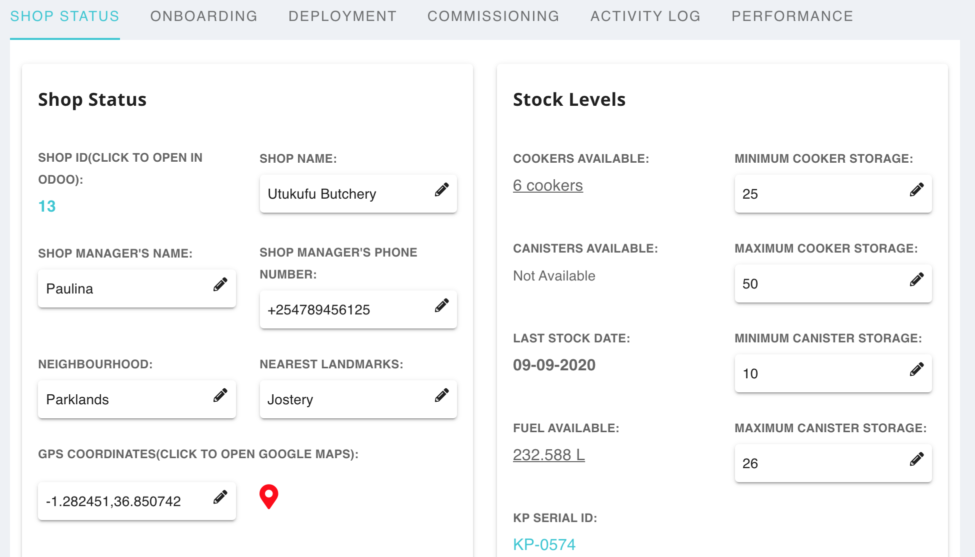
Shop Status
Most of this data is being pulled from Odoo.
Questions:
Is what’s in Odoo now correct?
How do we validate it?
Who needs to be involved?
GPS synced?
Neighborhood?
Landmark?

Slide 22
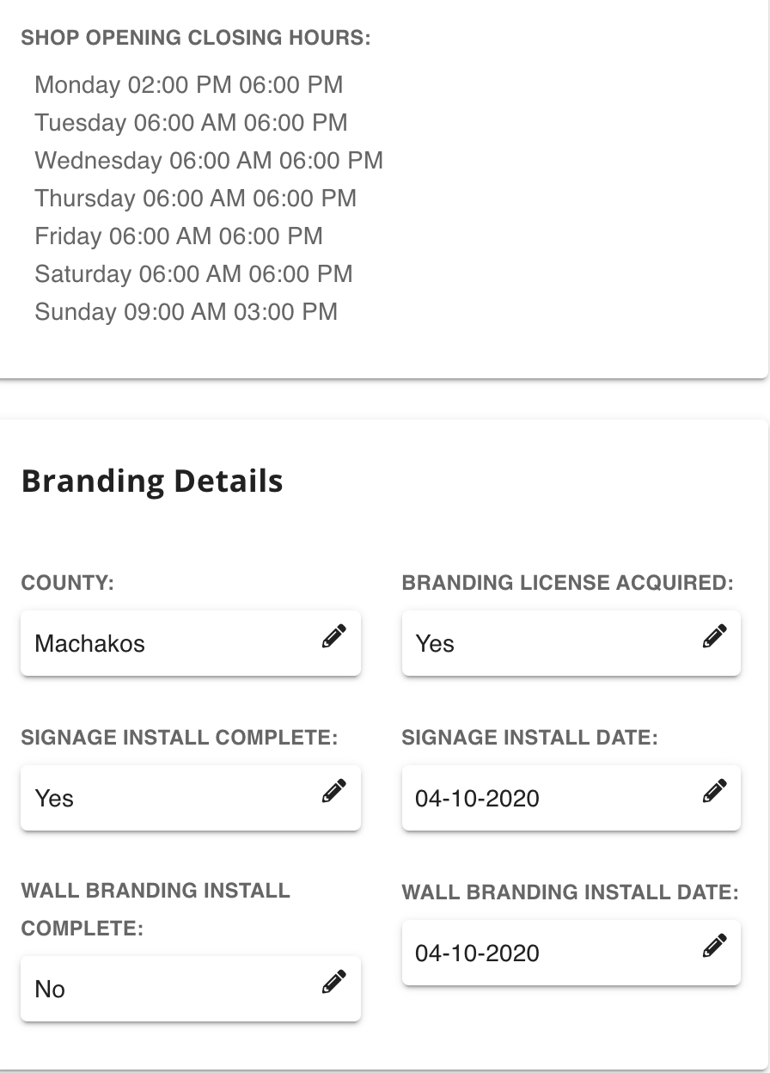
Opening Hours and Branding
The original proposal was to migrate this to Odoo. However the ongoing process (viewing and updating details will be in UVA).
Proposal:
Therefore we should not update opening hours in Odoo for now and wait until the UVA backend is ready before migrating Branding information.

Slide 23
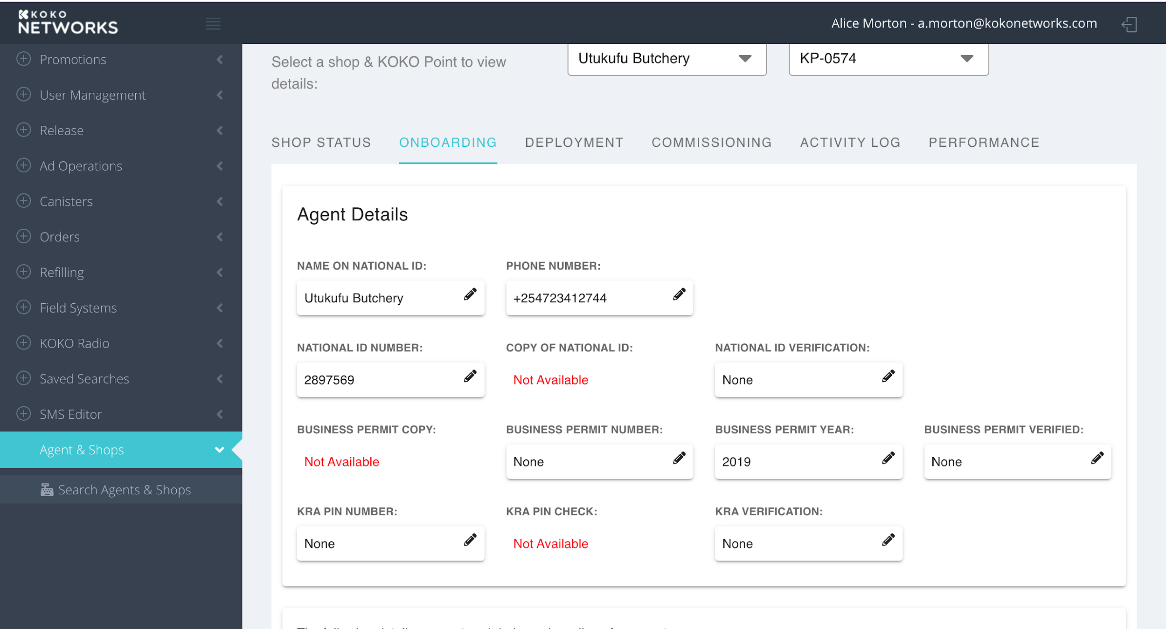
Agent KYC Info
This information is core KC information that Legal hold on the agent.
Questions:
Unless Finance needs this it will move to the UVA backend; migration will be paused until then.

Slide 24
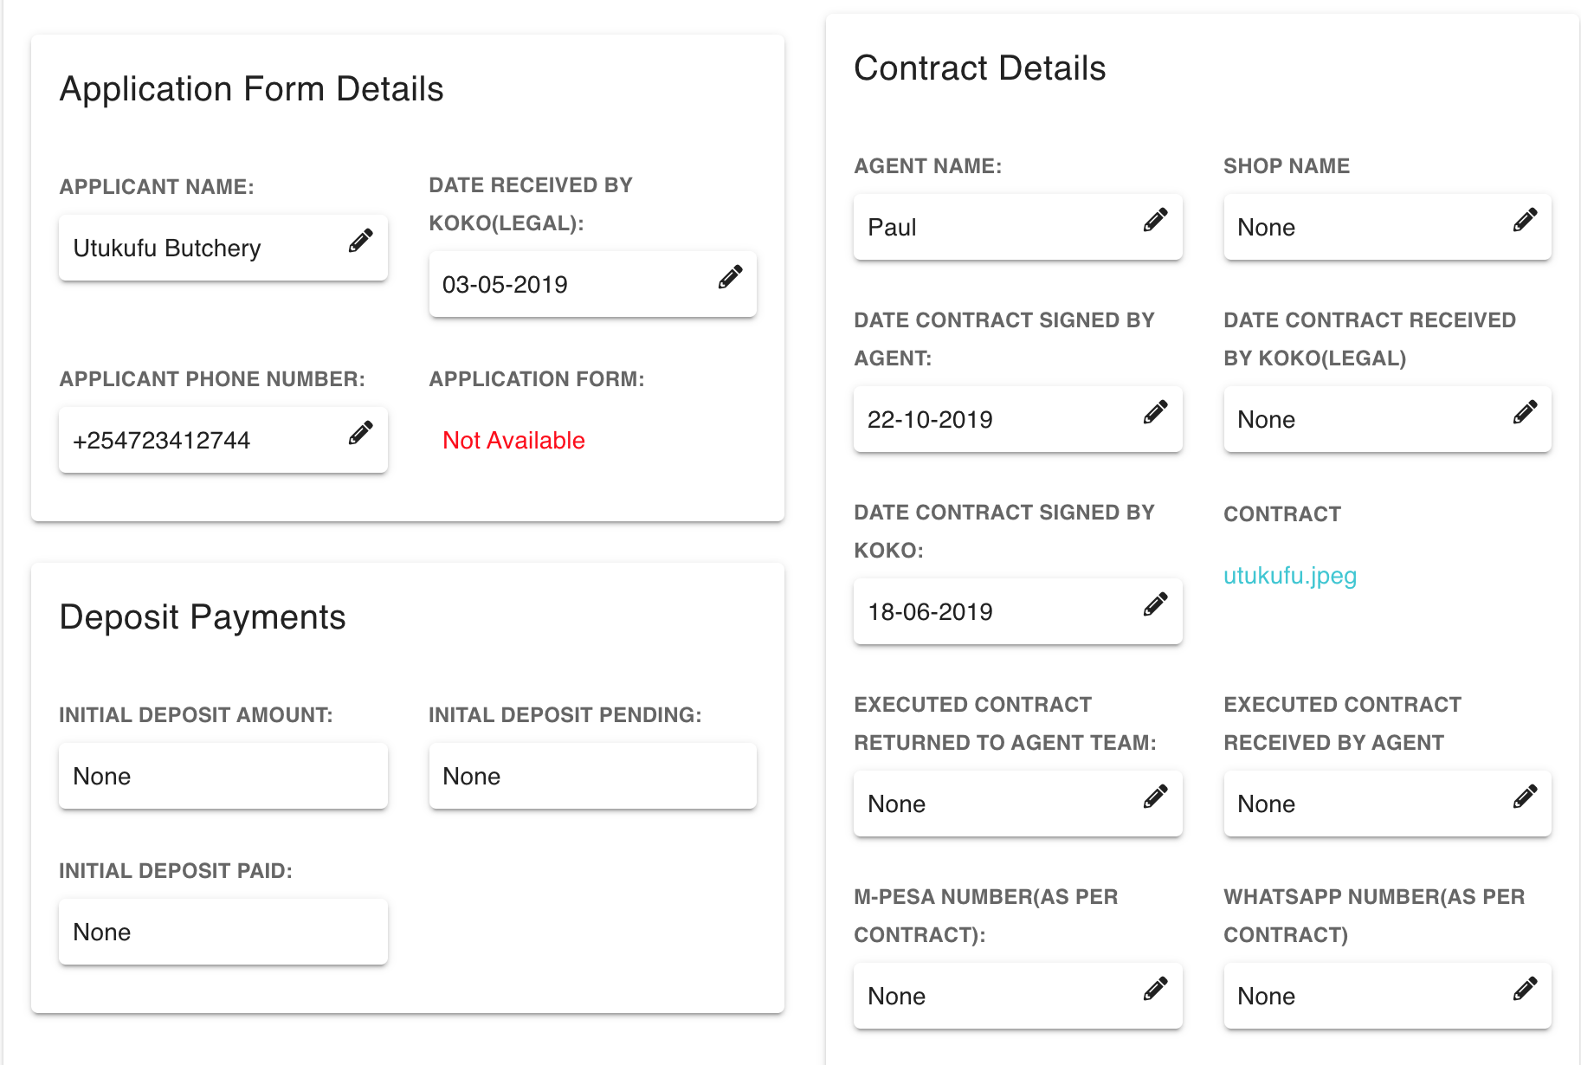
Agent Application Process Info
This is information we gather during agent onboarding. It serves both the Agent Network team in understanding where the agent sits in their pipeline, but is also critical from a legal and finance perspective… e.g. deposit and contract must be signed.
Proposal:
Migrate to UVA backend except deposits.
Define and prioritise new process for agent onboarding and shop creation.

Slide 25
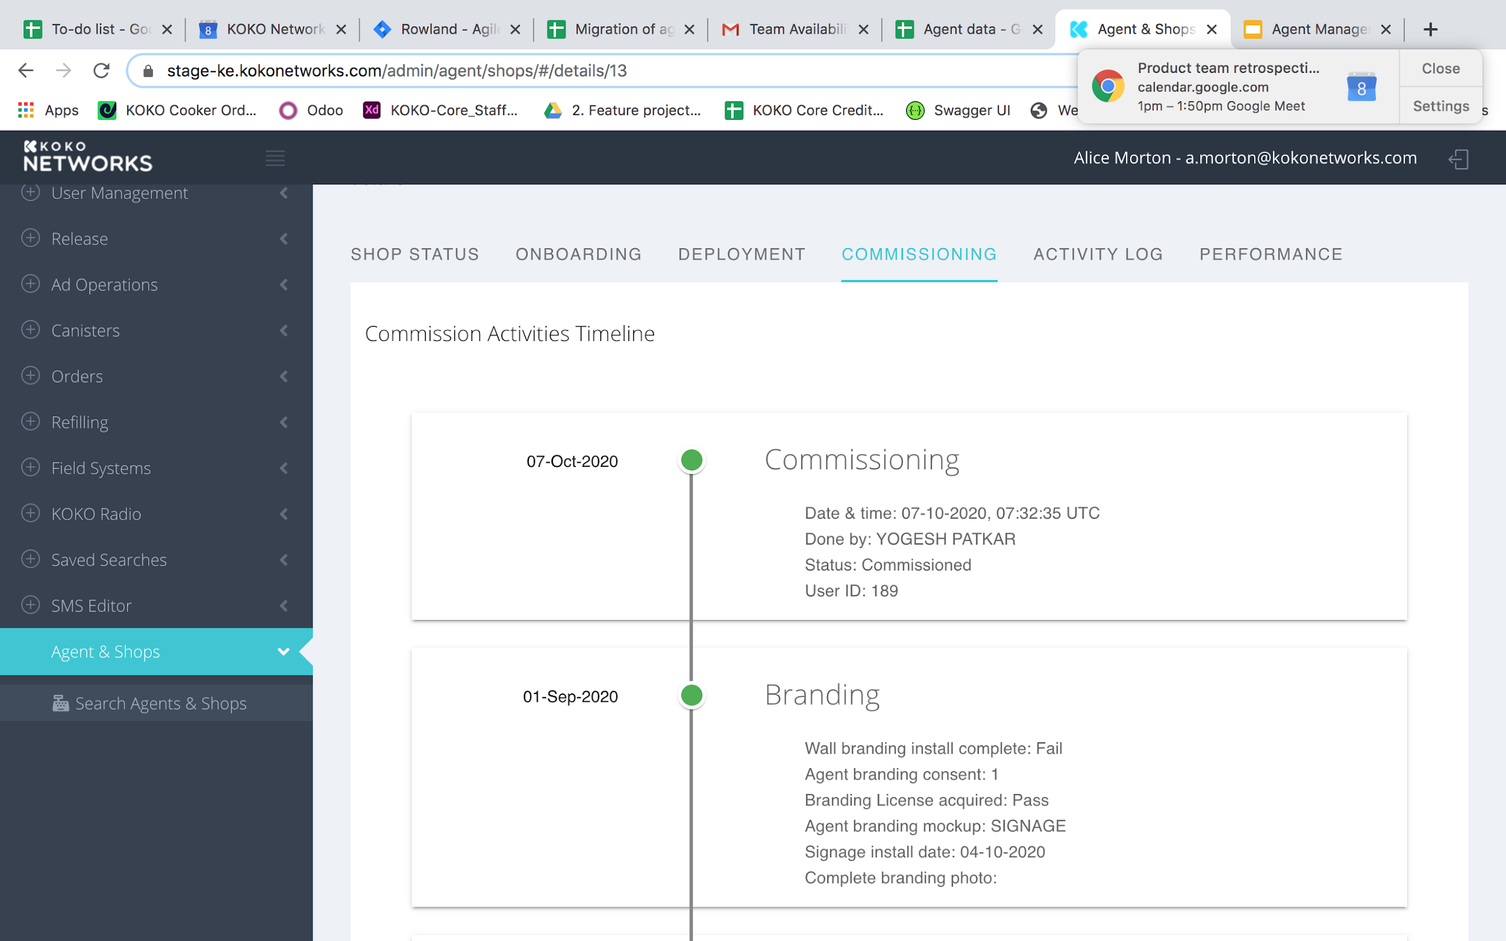
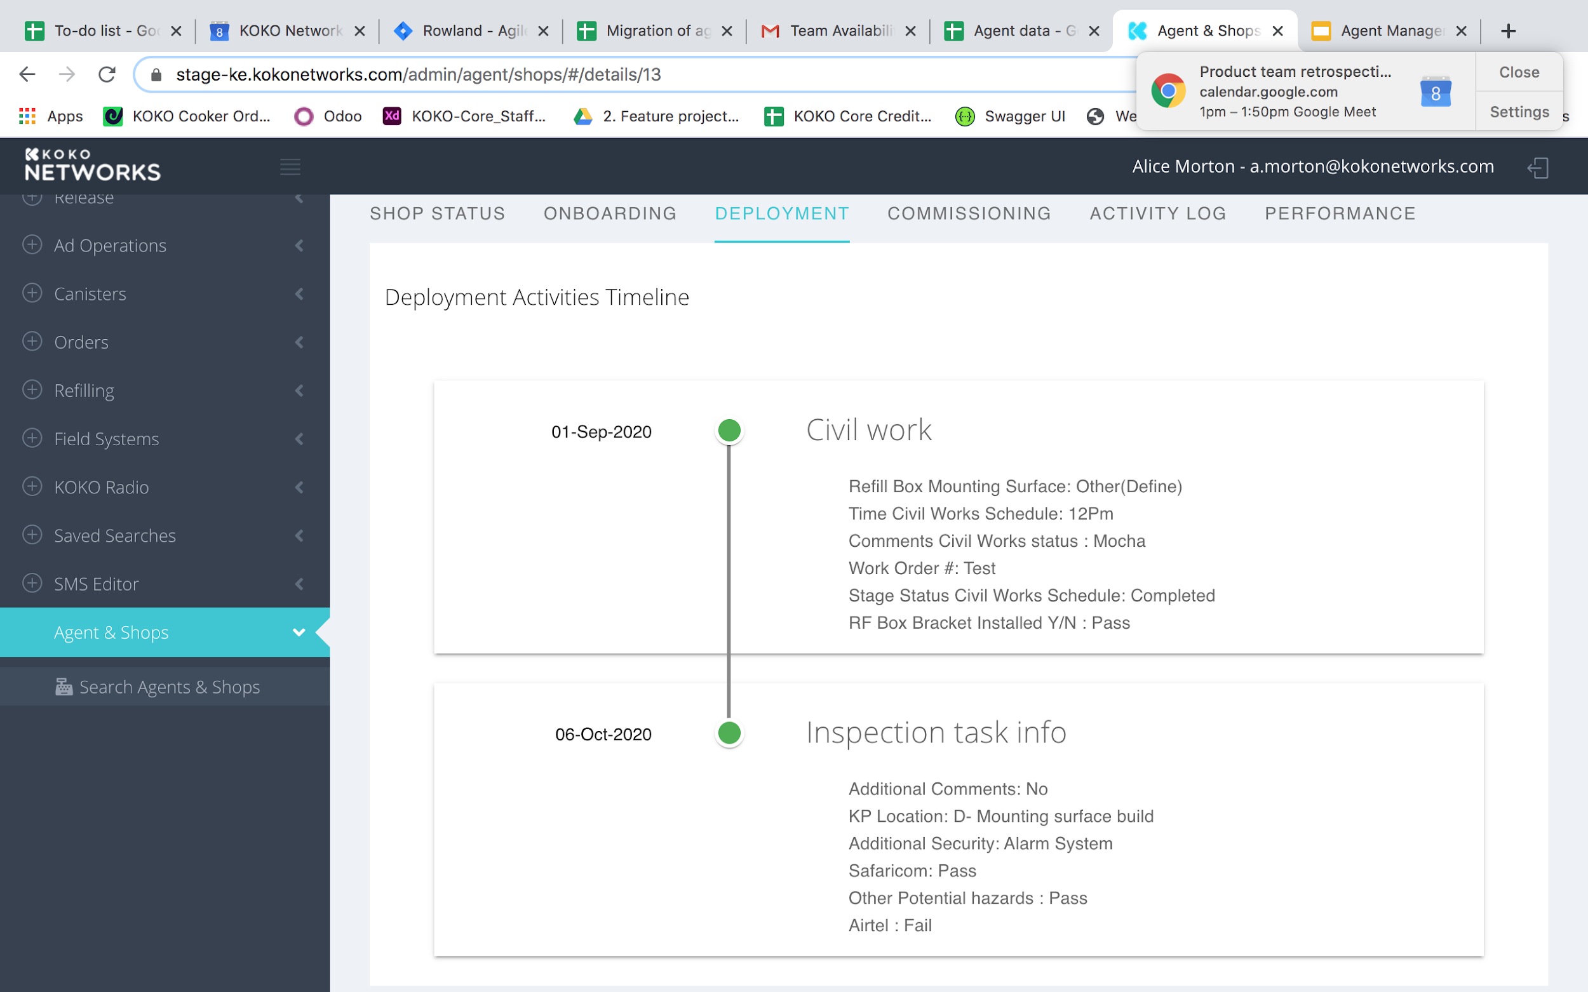
Deployment and Commissioning
This data is not editable in the new UVA. It is historic data required to understand when the KP was deployed and decommissioned. The current level of data required is far too detailed (300 rows) and it is unlikely the new process will be managed from Odoo.
Proposal: Hide these pages for now and revisit when looking at deployment and commissioning again.

Slide 26
Migrating data to Odoo
There are two potential approaches we can take which will both involve effort:
Migration is done by individuals nominated from the department
Hire an individual to work on the data migration and clean up.
The estimated timeline and effort is outlined here: Data Migration

Slide 27
New requirements
We have uncovered some new requirements which need prioritising:
Need to have multiple KPs in 1 shop - not achievable in current data structure but will be required for this view and also within the KOKOpoint section of KOKO Core.
As we are holding back the commissioning tab for now we still don’t have a view of whether a KP or shop is active. Need to add a couple of simple fields on the shop status page showing commissioned/decommissioned and potentially another one saying ‘do not fuel’. Shop online?
Need to breakdown the “Cooker Purchase” event that is on the customer,KP & now agent page to separate the cooker and the canister events.

Slide 28
Agent Backlog
Agile Delivery Approach

Slide 29







2H Agile Delivery Process (‘Pilot’)
Move fast (<1 week). Focus on getting just enough scope and structure to understand the desired outcomes and the highest priorities within those.
The whole Scrum team: How did we do and how can we work better?
Estimate (story points) the detailed items. Pick just enough that seem to be deliverable in one sprint.
Agent product offering
...
Agent task mgmt
UVA1,2,3
Sprint goal
Design, develop, unit test, integration test, and package code.
Sprint retrospective
Projects
2 week sprint
Deliver & release code
Deploy and release the increment (i.e. code) into Prod
High-level scoping
Backlog
Sprint planning
Backlog refinement
(for next 1-3 sprints)
Sprint review (incl. demo)
Many large, high-level items (epics). A few smaller, detailed ones (stories) - focused on the initial high priorities.
While the spring runs, review and revise the priorities in the backlog. Refine/detail the next set of epics into stories.
Demo the increment, discuss robustly, capture feedback for next sprints.
= Product & Engineering
= Functional stakeholders

Slide 30
What’s changing?
Ceremonies
Standups
Retros
Planning
Allocations
Demos
Release
Inbound Feature Requests
Prioritization
Scoping
Backlog

Slide 31
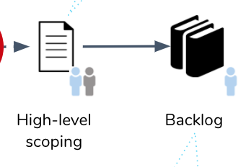
High level scoping / backlog
Scoping should become more collaborative going forwards and timeboxed where possible (design sprints?)
PMs will arrange sessions with Ari to understand the high level problems and then shadow individual team members on specific processes where necessary; as well as carrying out technical and business analysis in the background.
PMs will need to distill their scope into a product backlog on JIRA. This may not be the final version of the scope as engineers may add to it and break it down further.
The list on Jira will be prioritised on a two weekly basis with Ari ahead of sprint planning.
Picture of JIRA backlog

Slide 32
Ceremony Calendar
Week 1 | Monday | Tuesday | Wednesday | Thursday | Friday
 | Daily standup | Daily standup | Daily standup | Daily standup | Daily standup
 |  | Prioritization | Backlog Refinement | Demo | Sprint Retrospective
Week 2 | Monday | Tuesday | Wednesday | Thursday | Friday
 | Sprint Planning | Daily standup | Daily standup | Daily standup | Daily standup
Week 3 | Monday | Tuesday | Wednesday | Thursday | Friday
 | Daily standup | Daily standup | Daily standup | Daily standup | Daily standup
 |  | Prioritization | Backlog Refinement | Demo | Sprint Retrospective
Week 4 | Monday | Tuesday | Wednesday | Thursday | Friday
 | Sprint Planning | Daily standup | Daily standup | Daily standup | Daily standup
Week 5 | Monday | Tuesday | Wednesday | Thursday | Friday
 | Daily standup | Daily standup | Daily standup | Daily standup | Daily standup
 |  | Prioritization | Backlog Refinement | Demo | Sprint Retrospective
Daily Standup (15 minutes each day) Attendees: Scrum team
Backlog Refinement (1 hour, 1 week before new sprint begins) Attendees: Scrum team
Demo(½ - 1 hour, the day before the end of the sprint) Attendees: Scrum team, Business Stakeholders
Sprint Planning(½ - 1 hour, day 1 of new sprint) Attendees: Scrum team
Prioritization(½ - 1 hour, before backlog Refinement) Attendees: Business Stakeholders, Product team
Sprint Retrospective(½ hour, last day of the sprint)
For more details on each of the agile ceremonies read https://www.atlassian.com/agile/scrum/ceremonies

Slide 33
What are the ceremonies and what’s the point?
Sprint Planning | Daily Stand Up | Sprint Review | Sprint Retrospective | Engineering discussion?
At the beginning of each Sprint, the Sprint Planning Meeting takes place. The Product Owner and Scrum Team (with facilitation from the ScrumMaster) review the Product Backlog, discuss the goals and context for the items, and the Scrum Team selects the items from the Product Backlog to commit to complete by the end of the Sprint, starting at the top of the Product Backlog. Each item selected from the Product Backlog is designed and then broken down to a set of individual tasks. | Once the Sprint has started, the Scrum Team engages in another of the key Scrum practices: The Daily Stand-Up Meeting. This is a short (15 minutes) meeting that happens every workday at an appointed time. Everyone on the team attends. At this meeting, the information needed to inspect progress is presented. This information may result in replanning and further discussions immediately after the Daily Scrum. | Also known as sprint demo. After the Sprint ends, there is the Sprint Review, where the Scrum Team and stakeholder inspect what was done during the Sprint, discuss it, and figure out what to do next. Present at this meeting are the Product Owner, Team Members, and ScrumMaster, plus customers, stakeholders, experts, executives, and anyone else interested. | Following the Sprint Review, the team gets together for the Sprint Retrospective which is an opportunity for the team to discuss what’s working and what’s not working, and agree on changes to try. | Traditionally part of sprint planning but at KOKO this was being done in advance of sprint planning - a mixture of backlog refinement and tech design

Slide 34
Demos
Demos are intended to demonstrate progress against sprint goals and capture feedback early.
They are no in lieu of PMs working with developers during the sprint.
Demos should form part of every sprint and include at least one key business stakeholder, Ari.
Depending on focus of the software being built in that sprint, the demo invite can be extended to other individuals and teams involved in managing the Agent Network (including and not limited to Ops, Finance, Agent Network)
All feedback and comments are encouraged during the demo but the demo should not be used to do a detailed requirements gathering session. The PM involved will arrange a subsequent follow up if this is required.
The demo should be run by software team members, and attended by PMs.
Demos should last no longer than an hour.
They should not be treated as a detailed training session; business change requirements / feature launch requirements should be driven by the PM.

Slide 35
Releases
Sprint testing
Feature level testing
Backward compatibility and release testing plan
Deployment plan including rollback
Smoke testing

